Slide 1






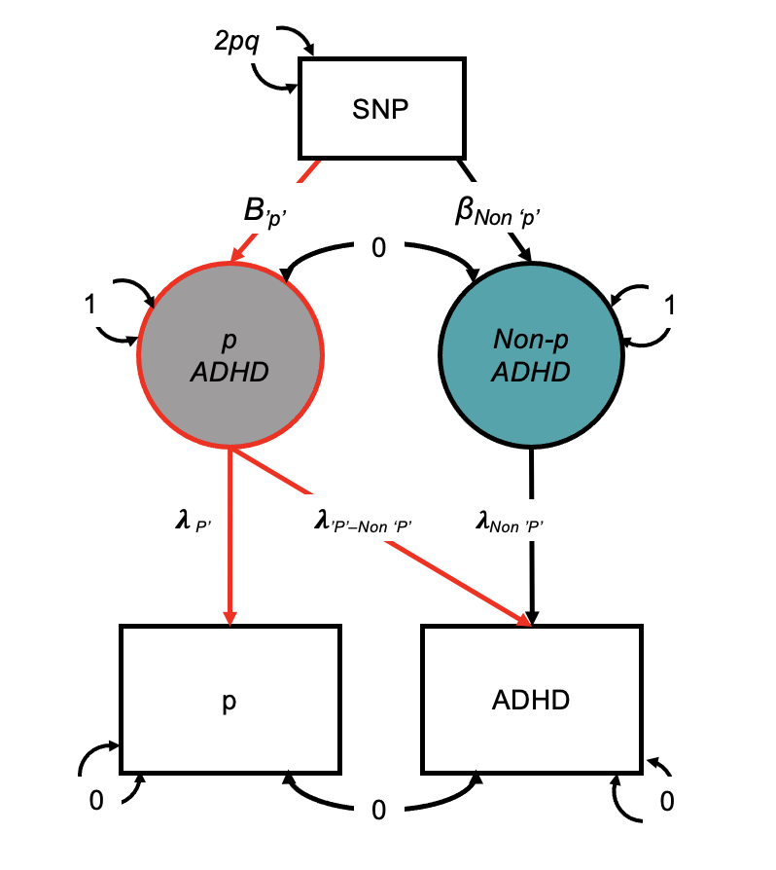
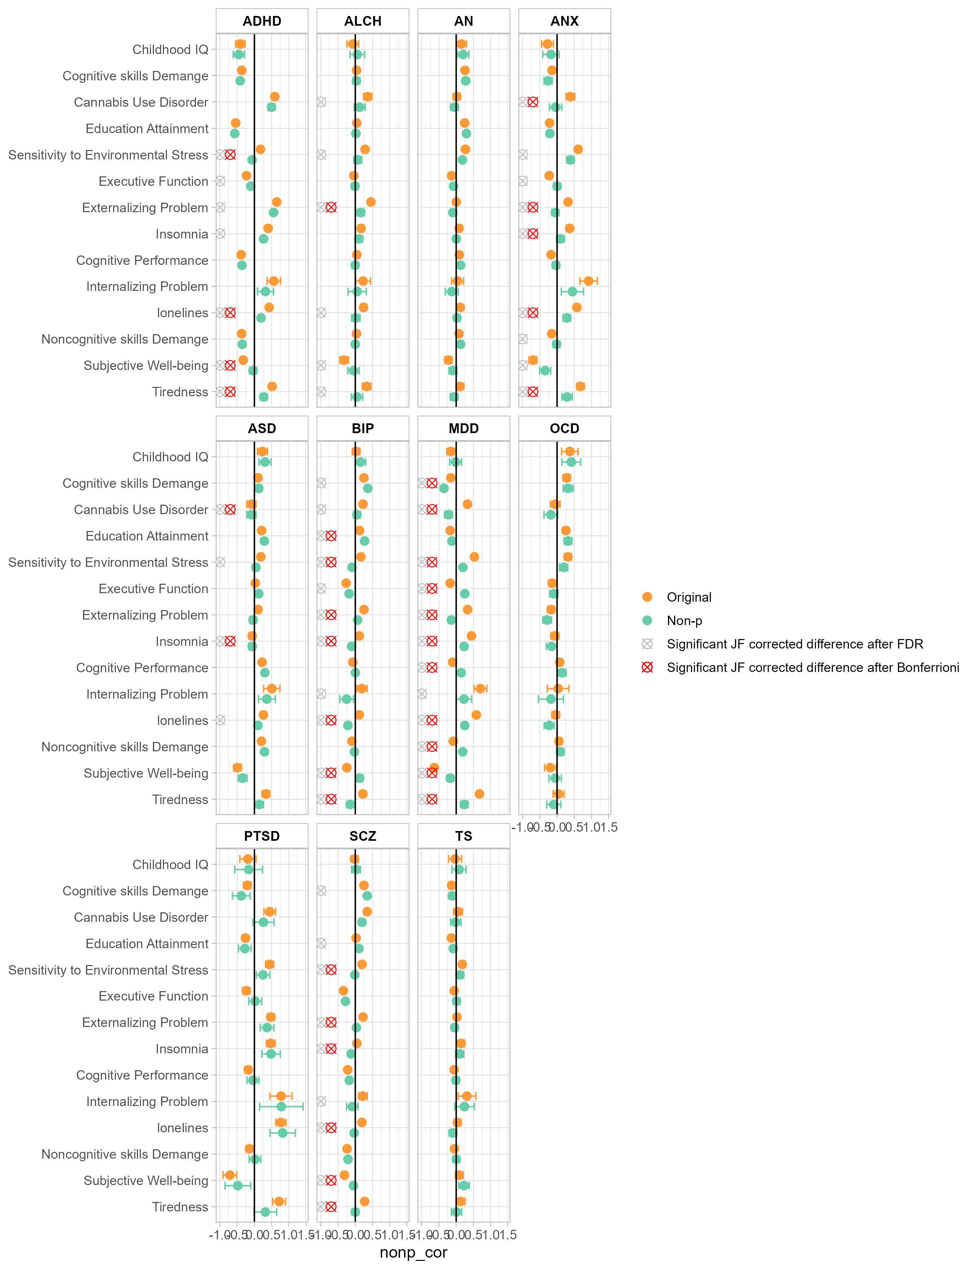
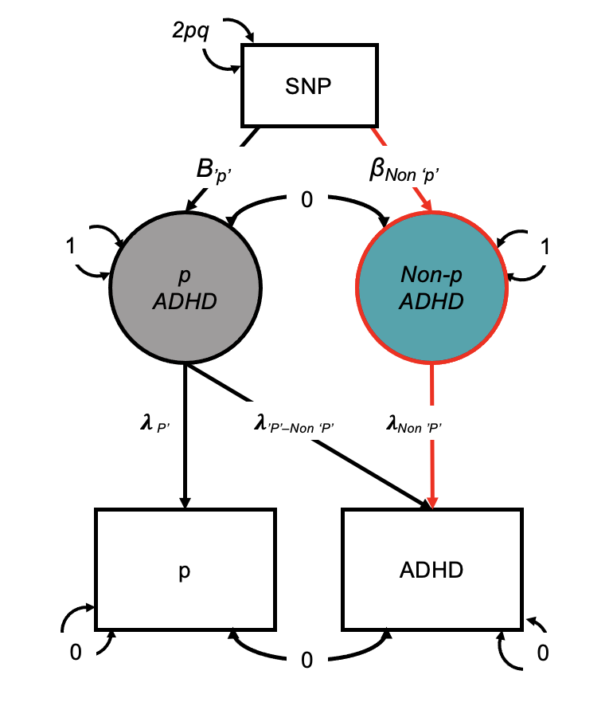
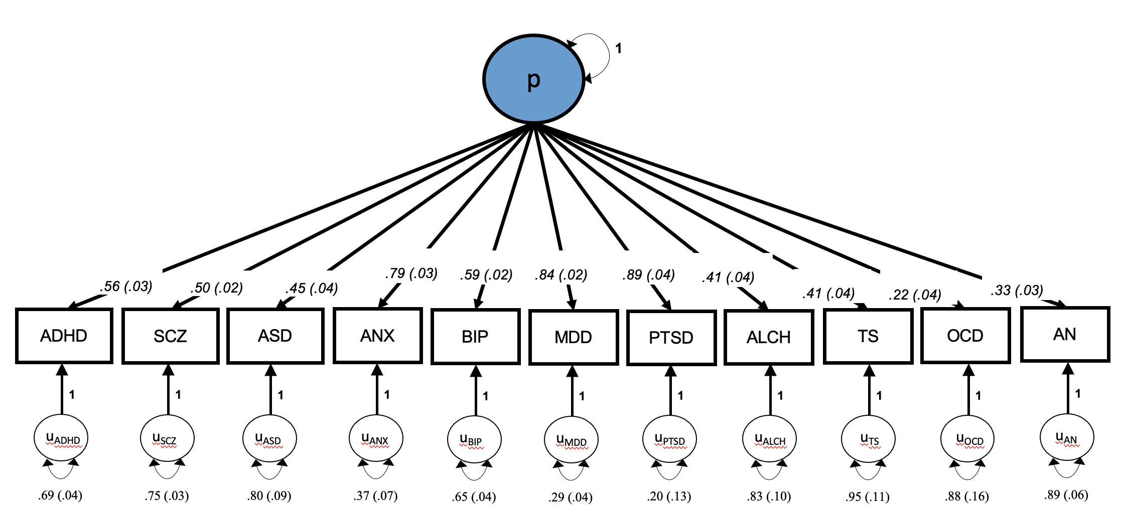
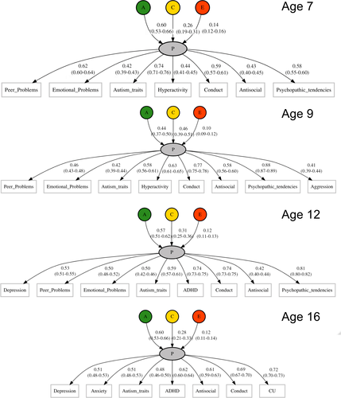
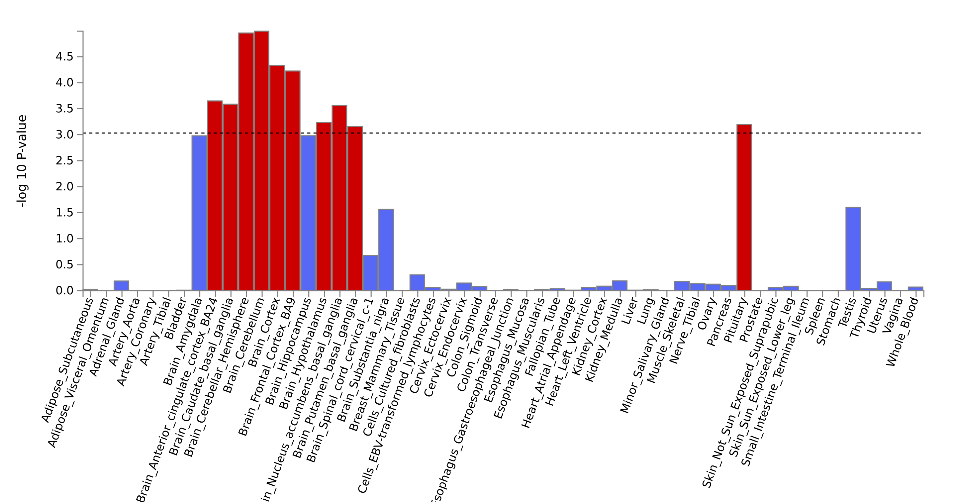
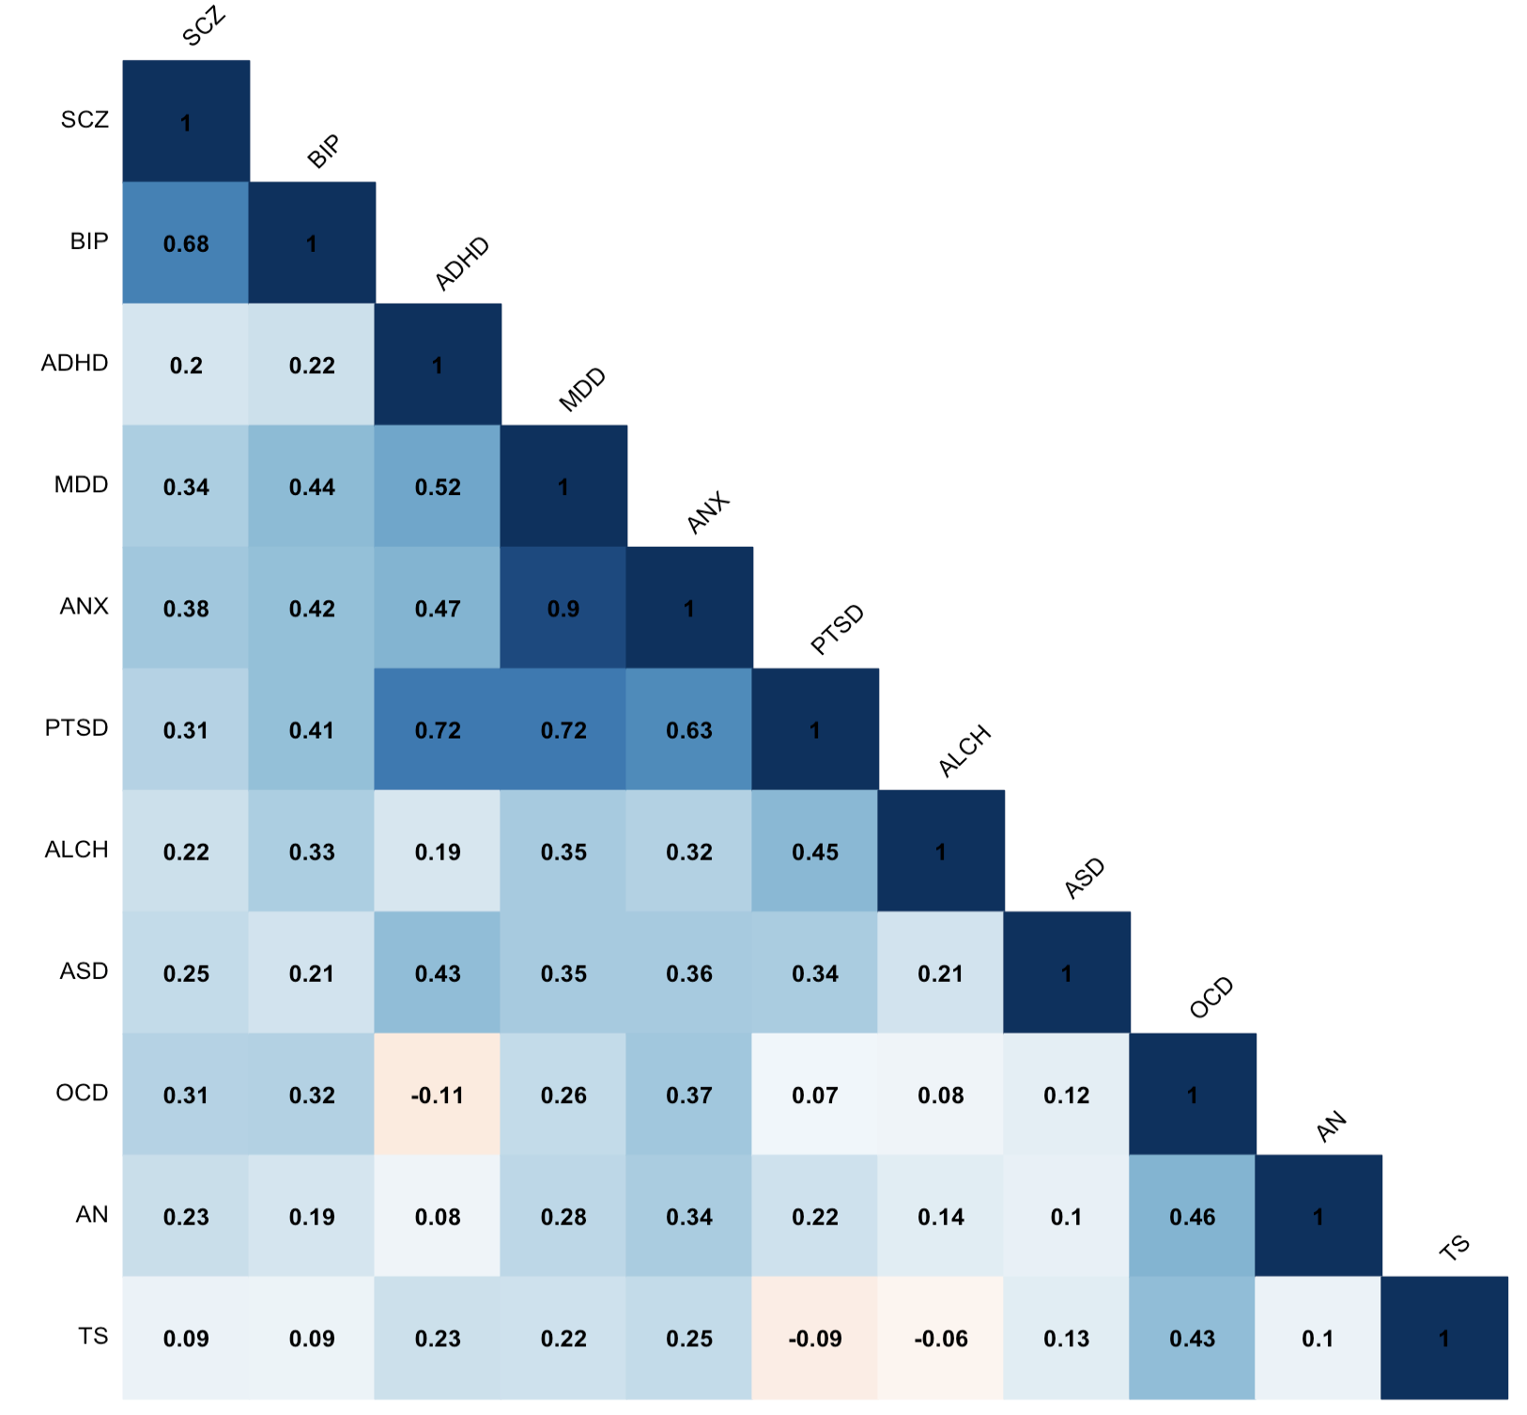
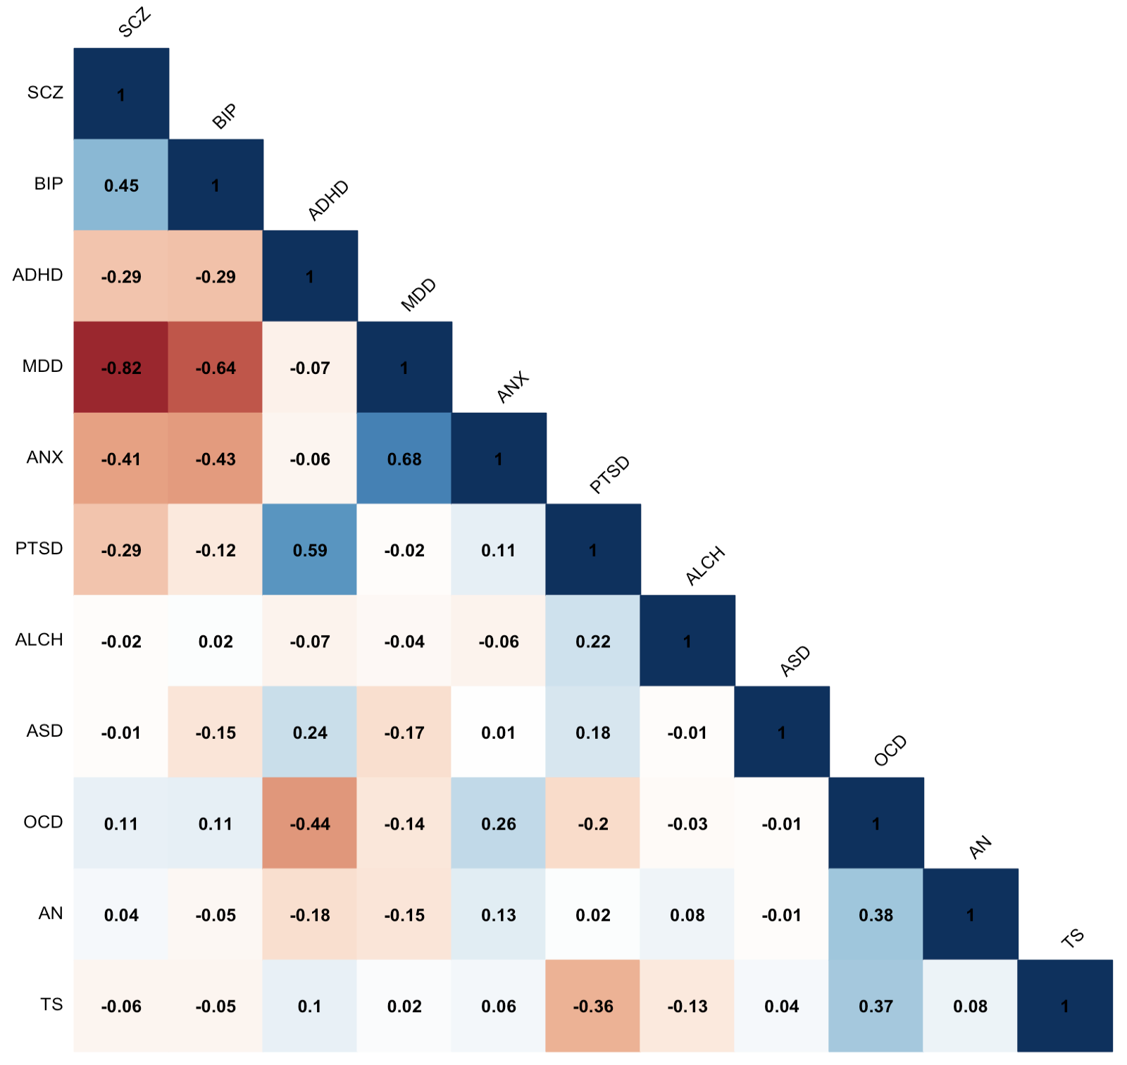
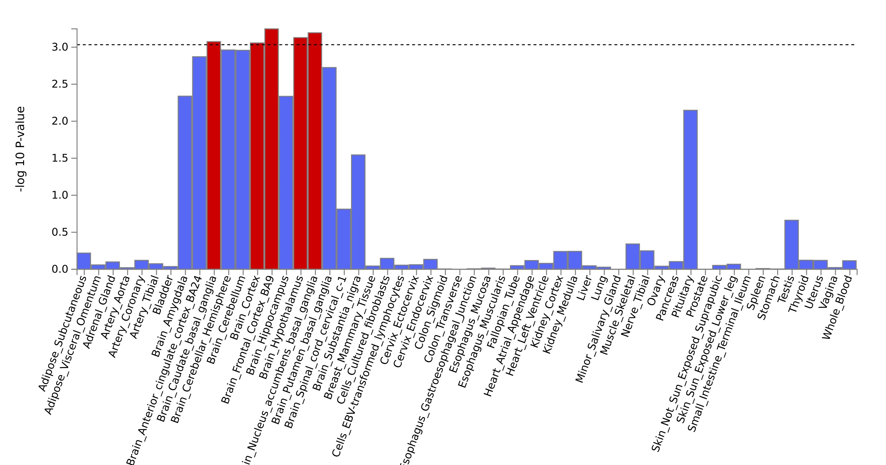
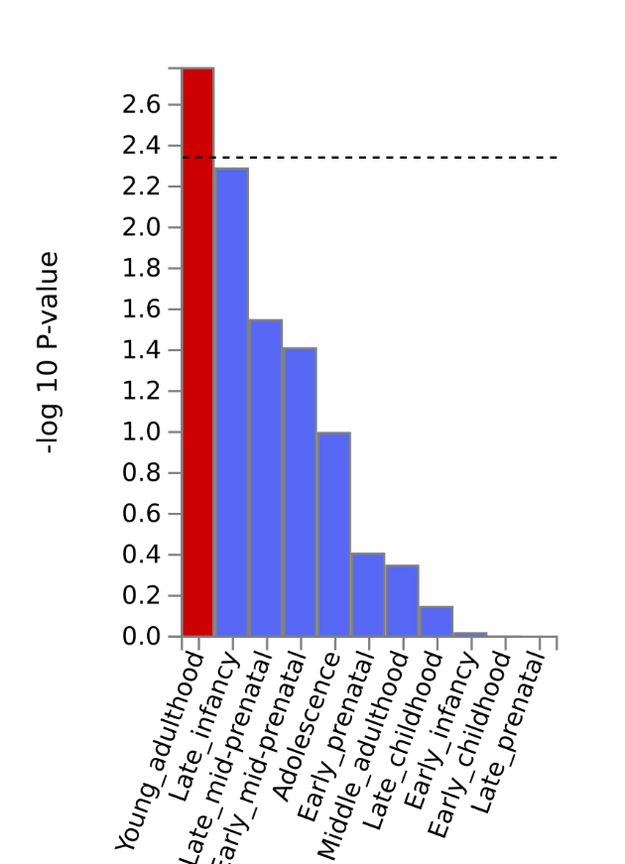
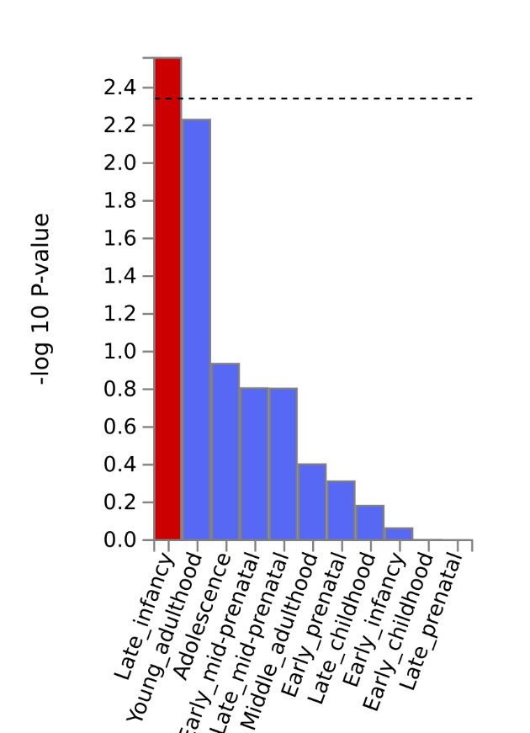
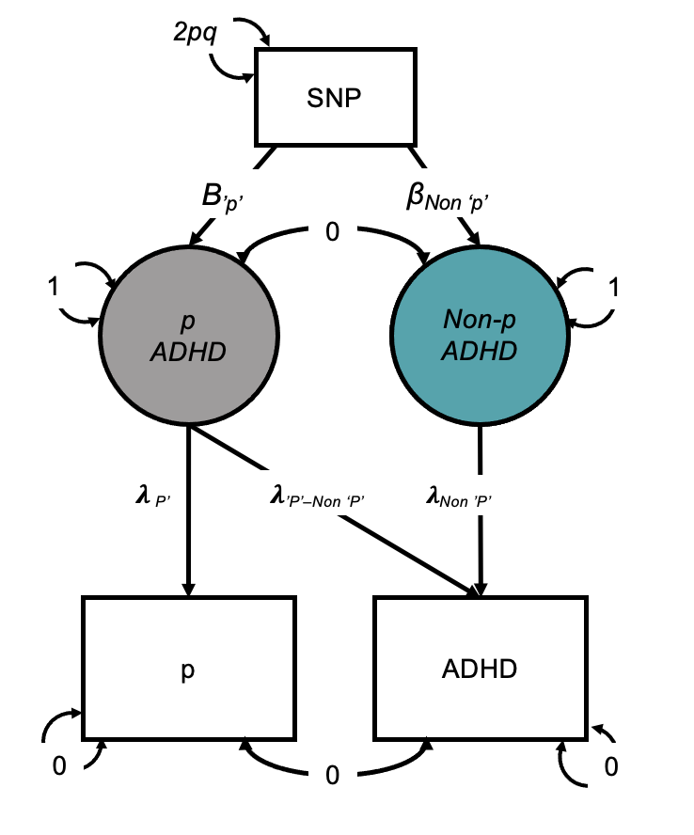
Controlling for the general psychopathology factor p in genomic research on psychiatric disorders – Part 2
Wangjingyi Liao^{1,5}, Engin Keser^{2,5}, Andrea G. Allegrini³, Kaili Rimfeld^{2,4}, Robert Plomin^{2,6} and Margherita Malanchini^{1,2,6}
¹ School of Biological and Behavioural Sciences, Queen Mary University of London ² Social, Genetic and Developmental Psychiatry Centre, King's College London ³ Department of Psychology and Language Science, University College London ⁴ Department of Psychology, Royal Holloway University of London ⁵These authors contributed equally ⁶ These authors jointly supervised the work * All authors have no conflicts of interest to disclose **The study was preregistered in OSF
Background – Recap of Part 1
RESULTS
We used GenomicSEM to conduct a common factor GWAS on 11 major psychiatric disorders
Significant changes in genetic correlations with external traits after controlling of p.
Novel genetic variant were identified in the
Non-ps
Current classification of psychiatric disorders does not reflect the genetic architecture of psychopathology.
Average Rg between 11 major psychiatric disorders was 0.28 (Grotzinger et al., 2022)
The General factor of psychopathology - ‘p’ (Caspi & Moffitt, 2018)
p is partially genetically driven (Selzam et al., 2018; Lee et al., 2019; Allegrini et al., 2020; Grotzinger et al., 2022), where the P-factor explains on average 20-50% of the genetic variance
The GWAS-by-Subtraction was then used to extract the disorder-specific genetic effects for the 11 disorders that are independent of p
e.g. Psychological traits
The number of independent significant SNP and novel SNPs associated with Non-p GWASs
Traits | Independent Significant SNP | Novel SNP
Schizophrenia | 114 | 33
BIP | 19 | 1
ADHD | 11 | 4
AN | 6 | 4
ALCH | 2 | 0
GWAS of Non ‘p’
ADHD
1
rs4503294
-.045 (.008)
GWAS of Latent P
Different patterns of gene-set enrichment were found in tissue types and brain development after controlling of p.
Then we conducted LDSC to examine the genetic correlations between disorders after controlling for p
e.g. ADHD Tissue Type Enrichment
hemisphere
cerebellum
Significant Enrichment
pituitary
Not significant enrichment
Before residualizing for ‘p’
After residualizing for ‘p’
ADHD Original
Figure 1 from Grotzinger et al., 2022, showing the common pathway twin models of p at different ages in the TEDS sample. The heritability of p across different ages ranges from 50-60%.
cortex
frontal cortex
pituitary
Given the genetic influence of p on psychiatric disorders, controlling for p can better capture disorder specific genetic effects.
ADHD Non-p
e.g. BIP Brain Development Stage Enrichment
ADHD GWAS
p-factor GWAS
ADHD Non-p GWAS
BIP Original
PART 2 - Downstream analyses of P and Non-P
BIP Non-p
Aim: Comparing disorders before and after taking out p in downstream analyses
Genetic correlations with biobehavioural traits (Demographic, Anthropometric, Psychological and Health-related traits)
Novel loci identification
Gene, gene-set, tissue type and brain development stages enrichment
Method:
Independent significant hits of Non-ps
Novel Loci not identified in the previous GWAS
Identify the most relevant genes
Explore gene enrichment in the Tissue and the Brain
LDSC
Non-p correlations with external outcomes
MAGMA gene and gene-set analysis
Changes in rgs before and after controlling of p
LD Clumping
Conclusion
GWAS of disorder-specific genetic risk that is independent of p
Reveals a different genetic architecture of psychiatric disorders
Creates summary statistics for non-p to construct polygenic scores
Notes:
Given the interesting patterns of changes we found in the rgs between the 11 psychiatric disorders, it become worth investigating the biological underpinning of the Non-ps in our Part 2 of our project, the downstream analysis.
The aim of the part 2 of the project is to investigate and compare the disorders before and after taking out p in downstream analyses.
We conducted three part of downstream analysis: genetic correlation with external traits, novel genetic loci identification, and exploring the gene and gene-set enrichment in the Nonps
Firstly we examined the genetic correlation between Non-ps and external traits in 4 categories: demographic, health, psychological and anthropometric. Then we compare the Nonp correlations with the disorder original. We applied the jack-knife correction when comparing the rgs
Then we used LD clumping to sum up the GWAS signals across the genome and identified independent significant SNPs associated with the Non-ps. We compare our newly with the original GWAS in order to identify the genetic variants not identified in the original GWAS.
Finally we used the MAGMA in FUMA to identify gene and gene-sets are significant enriched in the Non-p summary statistics, as well as how different tissue types and brain development stage samples were enriched.
RESULTS
The genetic correlation results, taking the psychological related traits as an example.
5 out of the 11 disorders showed significant changes in rgs in this categories. MDD showed the most number of changes.
Most of the changes are reduction in rgs, but with exceptions.
Reversed correlation between MDD and executive function, cognitive performance, and noncognitive skills. The original negative correlations (-0.09 to -0.18) were switched to positive (0.15 to 0.25). Also, the positive correlation between BIP and loneliness (0.11) had become negative (-0.21)
Enhanced correlation between BIP and EA (0.13 to 0.27), and between MDD and cognitive skills (-0.16 to -0.36)
Thus this demonstrate three types of changes in the psychological categories
Reduction – p was explain the original association (most of the time)
Reversed – p was masking the true associations (second often)
Enhanced – p reduced the strength of original association (least often)
4 disorders identified the novel SNPs comparing with the original.
The schizophrenia Non-p gwas have the most number of novel SNPs. The most significant novel SNP is located around a schizophrenia and education attainment related gene SCZN16-AS1.
Changes in the tissue type and brain development stage enrichment were found
The most enriched brain area in the ADHD has changed from cerebellum and hemisphere to frontal cortex.
The most enriched brain development stage of BIP has changed from young adulthood to late infancy.

